Slide 1
Mini Project - VIth Semester
Human Activity Recognition System
Group Members :
Manan Mittal - IEC2018056
Likith Kumar - IEC2018064
Rayan Kejriwal - IEC2018080
Mini Project Supervisor - Dr. Rajat Sir
(HoD ECE, IIIT Allahabad)

Slide 2
What does our project do?

Slide 3
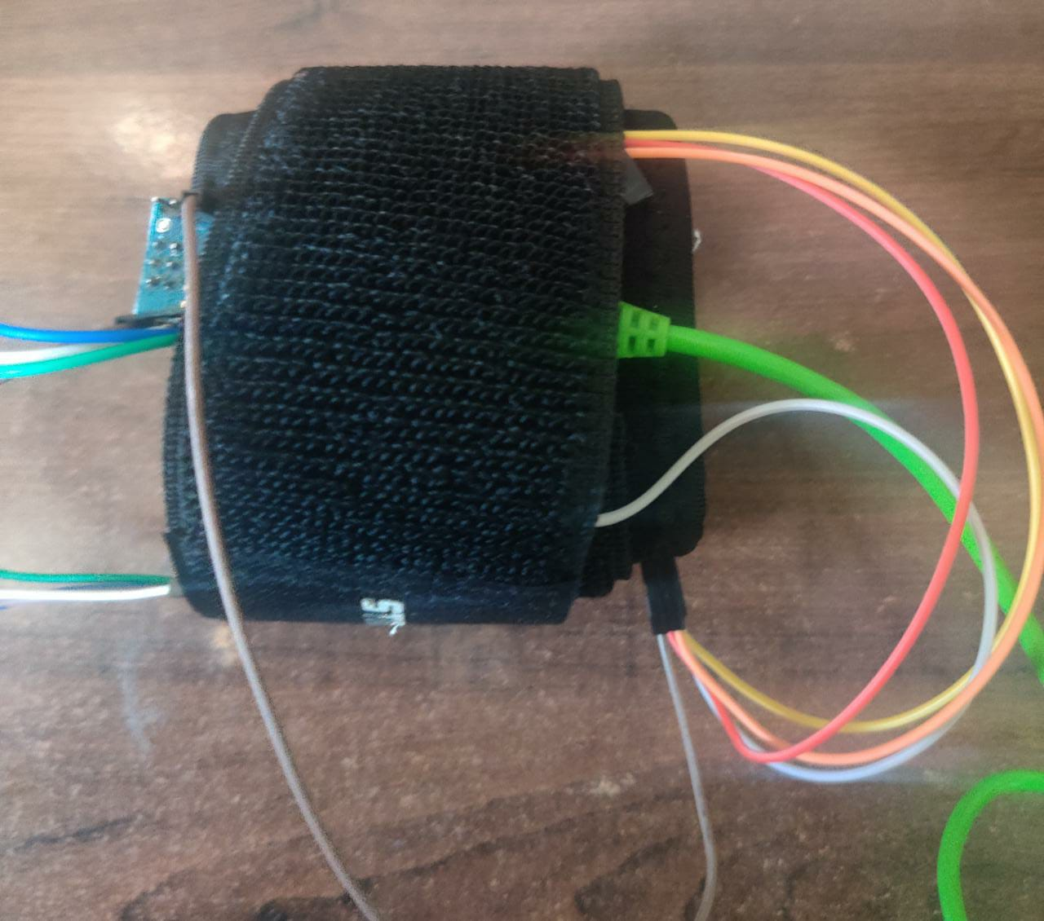
We have made a armband that can be worn conveniently by the user which classifies the user action into six
States - Sitting, Standing, Walking, Upstairs, Downstairs, Laying

Slide 4
Hardware
User Performs Activity
Data Collection through MPU 6050
A remote control controls the device and transmits the data to system
Software
Check Accuracy and Fitness
Data Analysis, Feature Engineering, Modeling, and Predictions on Test Data
Filtration of collected data to remove unnecessary noise and other irregularities
Methodology

Slide 5
Hardware Implementation

Slide 6
Components Used
MPU 6050 Chip
Arduino Nano
ESP8266

Slide 7
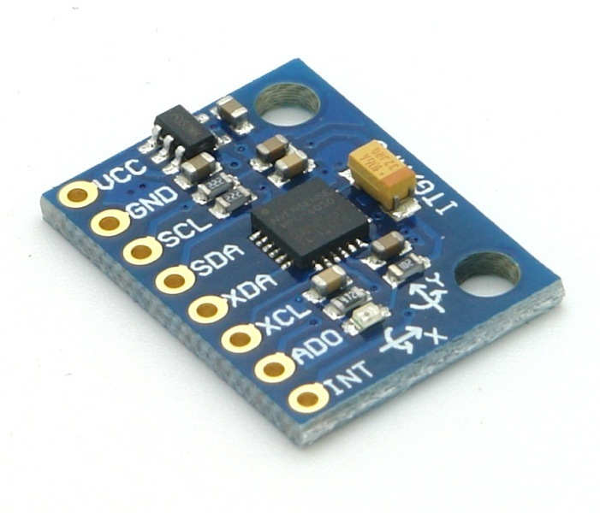
MPU 6050 Chip
The MPU-6050 chip is a Motion Tracking device which combine a 3-axis gyroscope and a 3-axis accelerometer on the same silicon die, together with an onboard Digital Motion Processor, which processes complex 6-axis MotionFusion algorithms. The device can access external magnetometers or other sensors through an auxiliary master I²C bus, allowing the devices to gather a full set of sensor data without intervention from the system processor.
Application in Our Project
We simply plan to make use of its GyroScope and Accelerometer sensor providing us with the information of the targeted object in the scope of 6 axis based motion discussion. This information will serve as raw data for our time series model to be able to classify the action of the object into six states that are sitting, standing, walking ,Laying

Slide 8
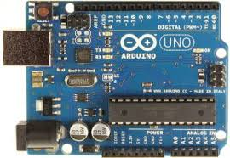
Arduino Kit
Arduino is an open-source electronics platform based on easy-to-use hardware and software. Arduino boards are able to read inputs - light on a sensor, a finger on a button, or a Twitter message - and turn it into an output - activating a motor, turning on an LED, publishing something online. You can tell your board what to do by sending a set of instructions to the microcontroller on the board. To do so you use the Arduino programming language (based on Wiring), and the Arduino Software (IDE), based on Processing.
Application in Our Project
We are using Arduino Kit to act as our main micro controller for directing our other components. It acts as our controller for both chip that is the main sensor and the remote controller. It communicates with the MPU6050 chip to gather the required data and transmits it through bluetooth module.

Slide 9
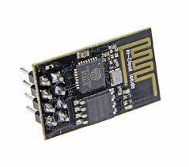
ESP8266
WIFI Module
The ESP8266 is a low-cost Wi-Fi microchip, with a full TCP/IP stack and microcontroller capability.This small module allows microcontrollers to connect to a Wi-Fi network and make simple TCP/IP connections using Hayes-style commands. The ESP8285 is an ESP8266 with 1 MiB of built-in flash, allowing the building of single-chip devices capable of connecting to Wi-Fi.
Application in Our Project
We have used the ESP8266 module as a communication link between our both chips and also the system on which we going to analyse the data for the desired results.

Slide 10
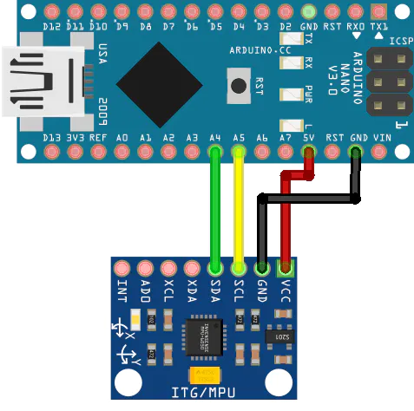
Arduino Nano-MPU6050
ArduinoNano MPU6050
5v ------------------------------------------------- Vcc
Gnd --------------------------------------------- Gnd
A5 ----------------------------------------------- SCL
- A4 ------------------------------------------- SDA

Slide 11
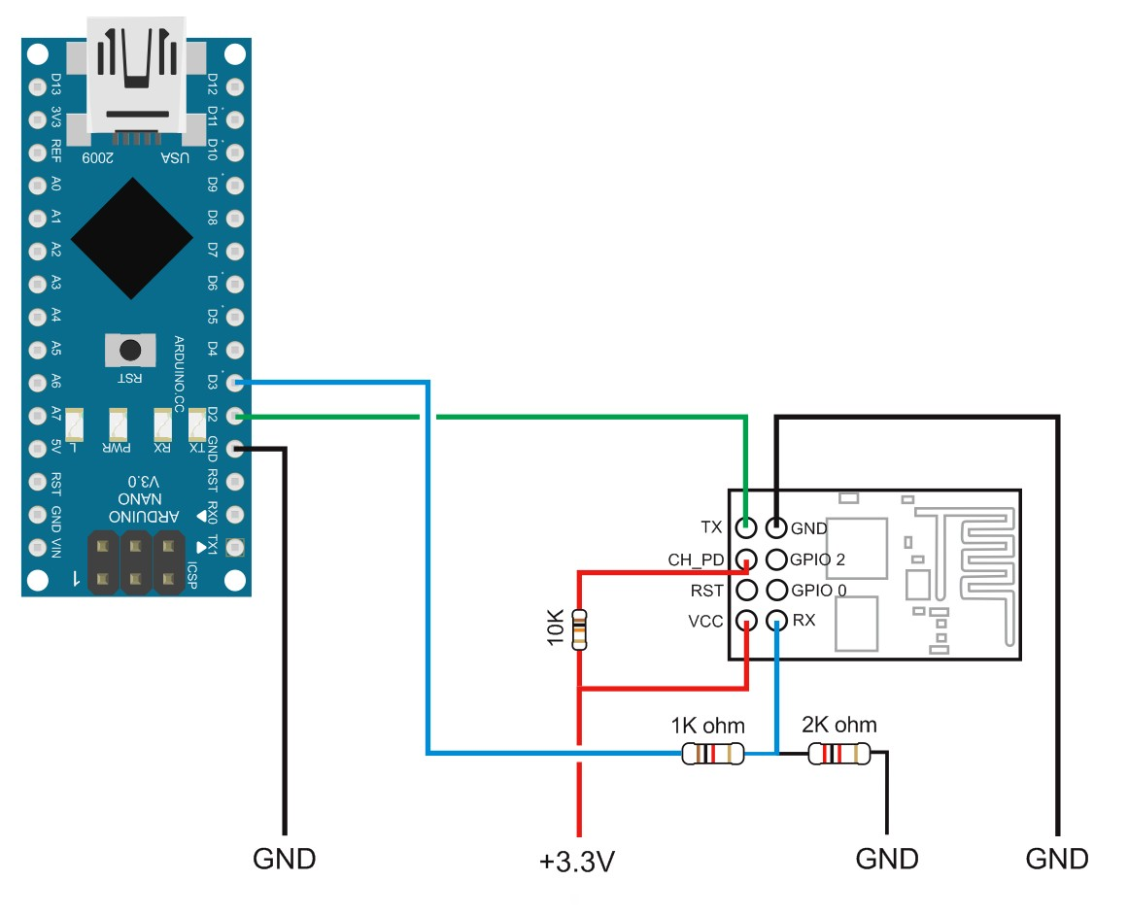
Arduino Nano-ESP8266
ArduinoNano ESP8266
3.3 ---------------------------------------------------- 3.3
3.3 ---------------------------------------------------- En
Gnd --------------------------------------------------- Gnd
Tx --------------------------------------------------- Rx
Rx --------------------------------------------------- Tx

Slide 12
Filtering of sensor acceleration and gyro signals

Slide 13
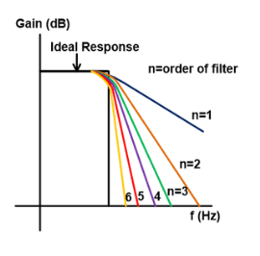
Butterworth Low Pass Filter
A Butterworth filter is a type of signal processing filter designed to have a frequency response as flat as possible in the passband. Hence the Butterworth filter is also known as “maximally flat magnitude filter”. The frequency response of the Butterworth filter is flat in the passband (i.e. a bandpass filter) and roll-offs towards zero in the stopband. The rate of roll-off response depends on the order of the filter. The number of reactive elements used in the filter circuit will decide the order of the filter.The inductor and capacitor are reactive elements used in filters. But in the case of Butterworth filter only capacitors are used. So, the number of capacitors will decide the order of the filter.

Slide 14
Choosing Appropriate Filters and their Orders
The features selected for this database come from the accelerometer and gyroscope 3-axial raw signals tAcc-XYZ and tGyro-XYZ.
These time domain signals (prefix 't' to denote time) were captured at a constant rate of 50 Hz.
They are to be filtered using a 3rd order low pass Butterworth filter with a corner frequency of 20 Hz to remove noise.
The acceleration signal was then separated into - body and gravity acceleration signals (tBodyAcc-XYZ and tGravityAcc-XYZ) using another low pass Butterworth filter with a corner frequency of 0.3 Hz.

Slide 15
Software Implementation

Slide 16
Feature Engineering
Deriving New Predictive Features
Approach - The idea is to add as many features as possible and then apply feature reduction techniques later to preserve only the most important features which are highly predictive and very uncorrelated with each other so as to maintain a perfect balance of bias and variance in our model.
Main Methods Used for Feature Addition :
1. We Specifically get 9 features after filtration > tGyro-XYZ + tBodyAcc-XYZ + tGravityAcc-XYZ
2. tBodyAcc-XYZ (body linear acceleration) and tGyro-XYZ (angular velocity) were derived in time to obtain Jerk signals (tBodyAccJerk-XYZ and tBodyGyroJerk-XYZ)

Slide 17
Feature Addition - Main Methods Cont..
3.
4.
*Here Mag is ref. to Magnitude - | |, f - as frequency domain, t - as time domain
Euclidean Norm is applied to 3-dimensional signals viz.
tBodyAcc, tGravityAcc, tBodyAccJerk, tBodyGyro, tBodyGyroJerk
To Correspondingly derive new set as
tBodyAccMag tGravityAccMag tBodyAccJerkMag tBodyGyroMag tBodyGyroJerkMag
Fast Fourier Transform (FFT) is applied to these signals to correspondingly derive new respectively set as -
fBodyAcc-XYZ fBodyAccJerk-XYZ fBodyGyro-XYZ fBodyAccJerkMag fBodyGyroMag fBodyGyroJerkMag

Slide 18
Some Other Statistical Features Added :
mean(): Mean value
std(): Standard deviation
mad(): Median absolute deviation
max(): Largest value in array
min(): Smallest value in array
sma(): Signal magnitude area
energy(): Energy measure -
Sum of the squares
divided by the number of values.
iqr(): Interquartile range
entropy(): Signal entropy
correlation(): correlation coefficient between two signals
maxInds(): index of the frequency component with largest magnitude
meanFreq(): Weighted average of the frequency components for mean frequency
skewness(): skewness of the frequency domain signal
kurtosis(): kurtosis of the frequency domain signal

Slide 19
Further Feature Engineering
Feature Reduction
> Reduction of Many Correlated and less Predictive Features as Modeling of High Dimensional Data is expensive.
> This will be carried out using techniques like PCA and T-SNE (clustering) algorithms.
Exploratory Data Analysis
> EDA is carried out to observe some of the underlying patterns and correlations among features so as to further calibrate the features
Feature Normalization

Slide 20
Data Modeling
Our First Approach was to try-out Neural Networks.
Other Machine Learning Algorithms like SVM, Logistic Regression,K-Means, Random Forest Classification, were also used to train the Multiclass model and the accuracies were compares
We used sk-learn’s accuracy_score a metrics to evaluate our Model’s Performance.

Slide 21
Testing and Inference
We tested our data model on the data collected in a previous Dataset. We trained our data Model and further test our model on the basis of separated test data (30% of total data) before deploying it in our application.
We further carried out hyperparameter optimization to further improve the proposed model’s Accuracies.
Finally, We have averaged out the predictions using Ensembling our 4 Models Based on its performance which will be exported as ‘.pkl’ file to be deployed.

Slide 22
Results

Slide 23
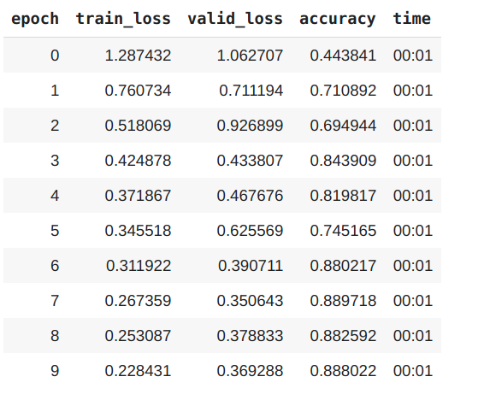
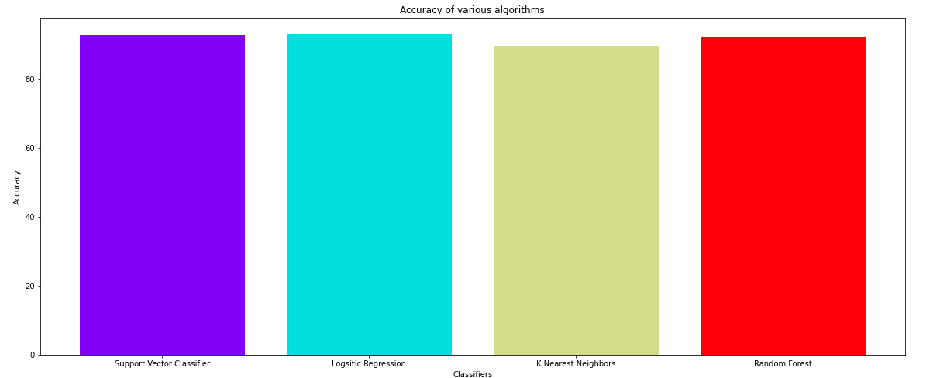
While Training
Other Algorithms Comparison
Neural Network Developed

Slide 24
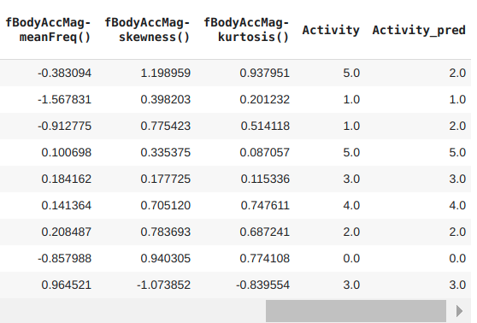
Results : Sample Predictions on Validation Set
Each of the float variables represent a class [0.0,6.0] ->
1
learn.dls.vocab
['LAYING', 'SITTING', 'STANDING', 'WALKING', 'WALKING_DOWNSTAIRS', 'WALKING_UPSTAIRS']

Slide 25
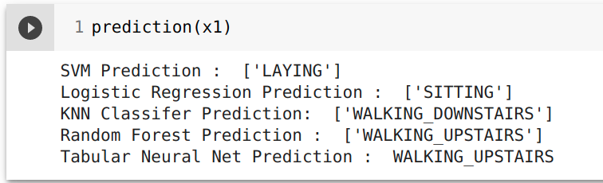
Results : Realtime Predictions

Slide 26
References
Davide Anguita, Alessandro Ghio, Luca Oneto, Xavier Parra and Jorge L. Reyes-Ortiz. Human Activity
Recognition on Smartphones using a Multiclass Hardware-Friendly Support Vector Machine. International
Workshop of Ambient Assisted Living (IWAAL 2012). Vitoria-Gasteiz, Spain. Dec 2012
Davide Anguita, Alessandro Ghio, Luca Oneto, Xavier Parra and Jorge L. Reyes-Ortiz. Human Activity
Recognition on Smartphones using a Multiclass Hardware-Friendly Support Vector Machine. 4th International
Workshop of Ambient Assisted Living, IWAAL 2012, Vitoria-Gasteiz, Spain, December 3-5, 2012. Proceedings.
Lecture Notes in Computer Science 2012, pp 216-223.
Jorge Luis Reyes-Ortiz, Alessandro Ghio, Xavier Parra-Llanas, Davide Anguita, Joan Cabestany, Andreu
Català. Human Activity and Motion Disorder Recognition: Towards Smarter Interactive Cognitive
Environments. 21th European Symposium on Artificial Neural Networks, Computational Intelligence and
Machine Learning, ESANN 2013. Bruges, Belgium 24-26 April 2013.

